Slide 1
Unit Testing in PyCharm
Brandon Krakowsky

Slide 2
Creating & Running a Testing File in PyCharm

Slide 3
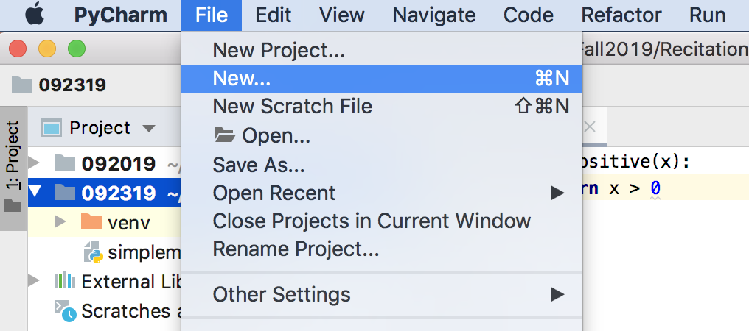
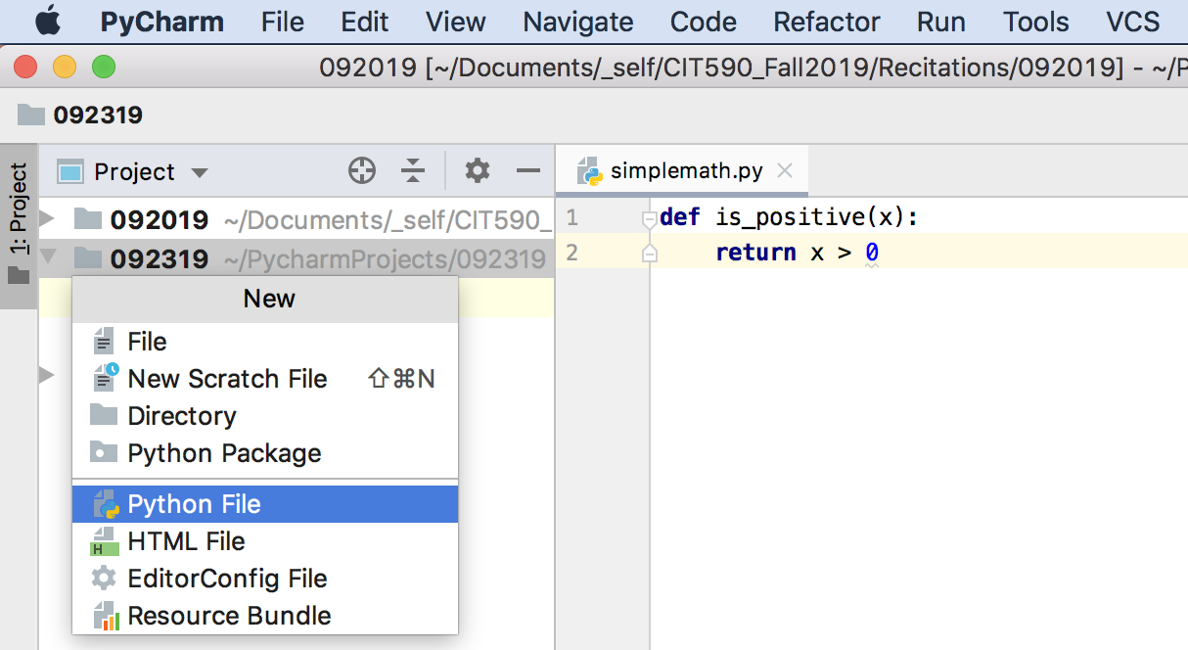
Creating a Testing File in PyCharm
In PyCharm, you can easily create a new testing file by going to “File” → “New”
And then by selecting “Python File”

Slide 4
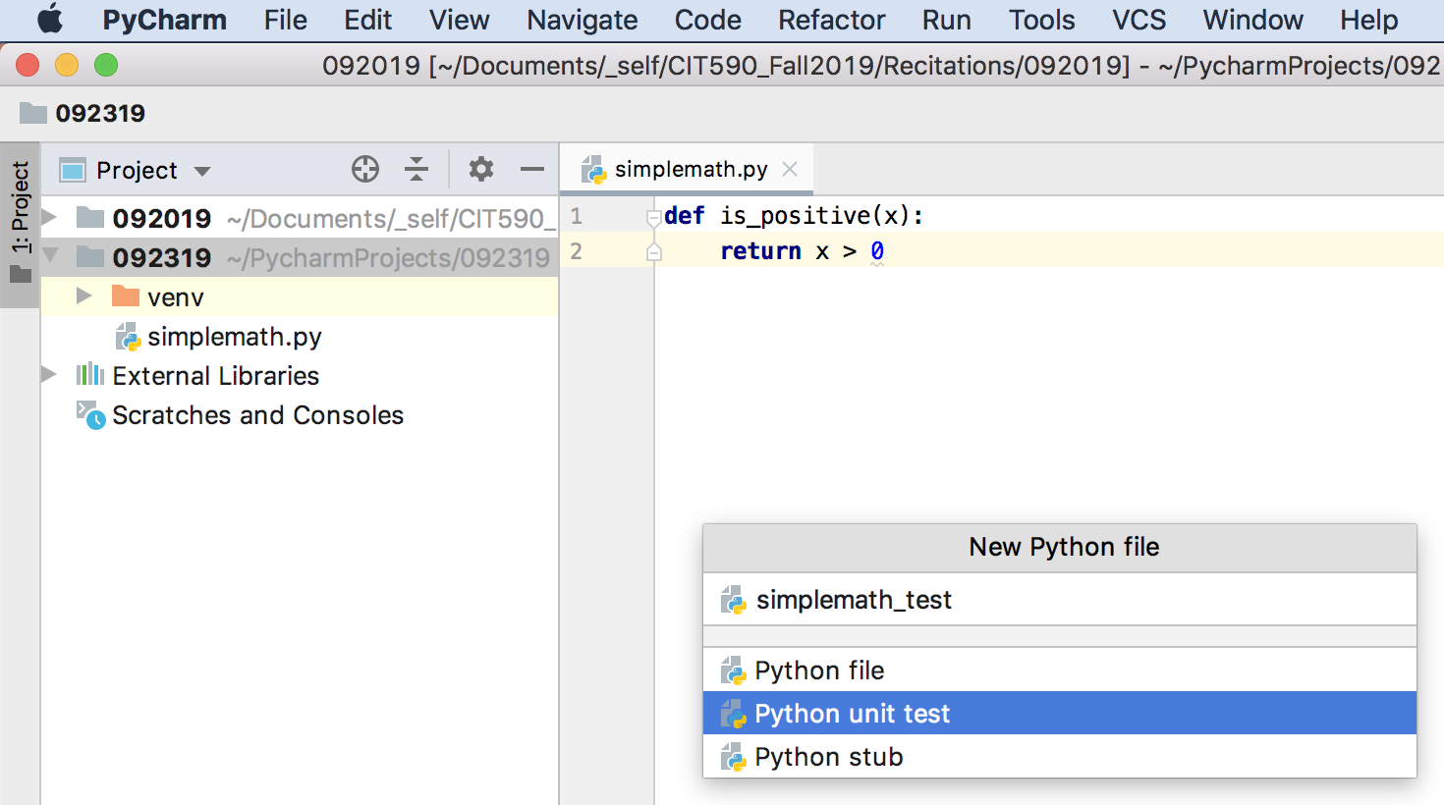
Creating a Testing File in PyCharm
Select “Python unit test”

Slide 5
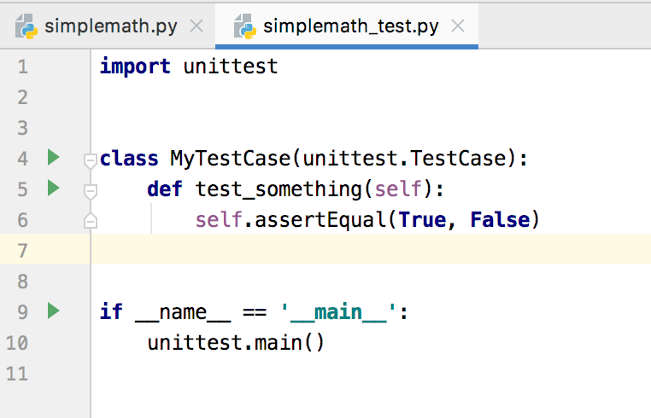
Creating a Testing File in PyCharm
This file won’t look EXACTLY like you want, but it’s a good start
At the very least, you’ll have to:
Import the program (file) you want to test
Change the testing class name
And create test methods, of course!

Slide 6
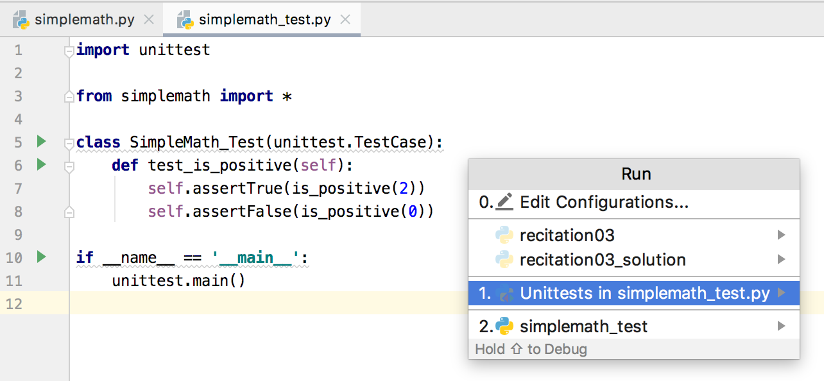
Running a Testing File in PyCharm
Run your unit testing file like any other Python file

Slide 7
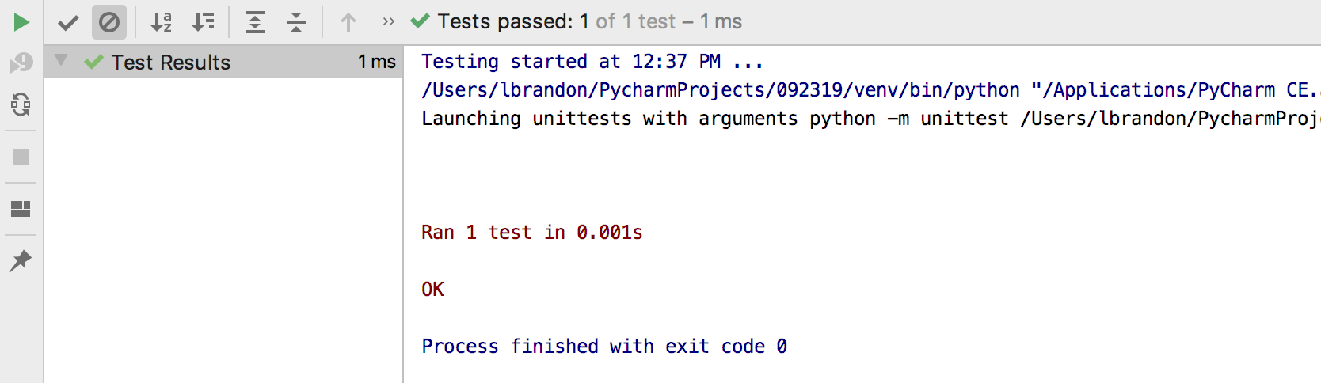
Running a Testing File in PyCharm
You’ll see the results of your tests in the Run Tool Window

